Slide 1


From Chaos to order：
AI simulation research on the property rights
Writer：Shiyu Liu
——Using the Yulan Large Model for Research

Slide 2


01
From 1848 California
Gold Rush
Background introduction

Slide 3





The problem with economics’
“default settings”
  Research
  starting point
  The chaos of reality
In a "no man's land" without government and law, who can decide who a piece of land belongs to?
  John Umbeck‘ theory
In an “anarchy” without law, potential violence is the ultimate constraint that determines the initial allocation of resources.

Slide 4
Deficiencies of traditional simulation methods
History cannot be repeated
Variables are uncontrollable
History is one-off, and we can't "rerun" the gold rush to test different conditions。
History is full of complex "noise", such as individual differences, information asymmetry, accidental events, etc., which are difficult to separate the core mechanism.
Rule-based agent modeling behavior is rigid
Data is incomplete
Only the written record of survivor bias can be relied upon, and the decision-making process of each individual cannot be observed.
Agents follow preset simple rules (e.g., IF the opponent retreats THEN) and cannot simulate complex human behavior.

Slide 5

02
Our motivation
Research paradigm

Slide 6
LLM agent simulation
Simulate complex
decisions
01
Paradigm
breakthrough
02
03
Achieve social
interaction
04
Controllable
sandbox
LLM agents have both human-like complex reasoning capabilities and can be placed in a controlled digital experimental environment
Be able to weigh the costs of violent conflict against the benefits of land possession, just like real gold diggers.
Able to negotiate, threaten, form alliances through natural language, and finally spontaneously form contracts to allocate resources.
  We can accurately set the ability (power) and resource distribution of each agent, and systematically verify the theoretical inference that "power is axiom" through repeated experiments.

Slide 7


03
Methodology
Experimental methods

Slide 8


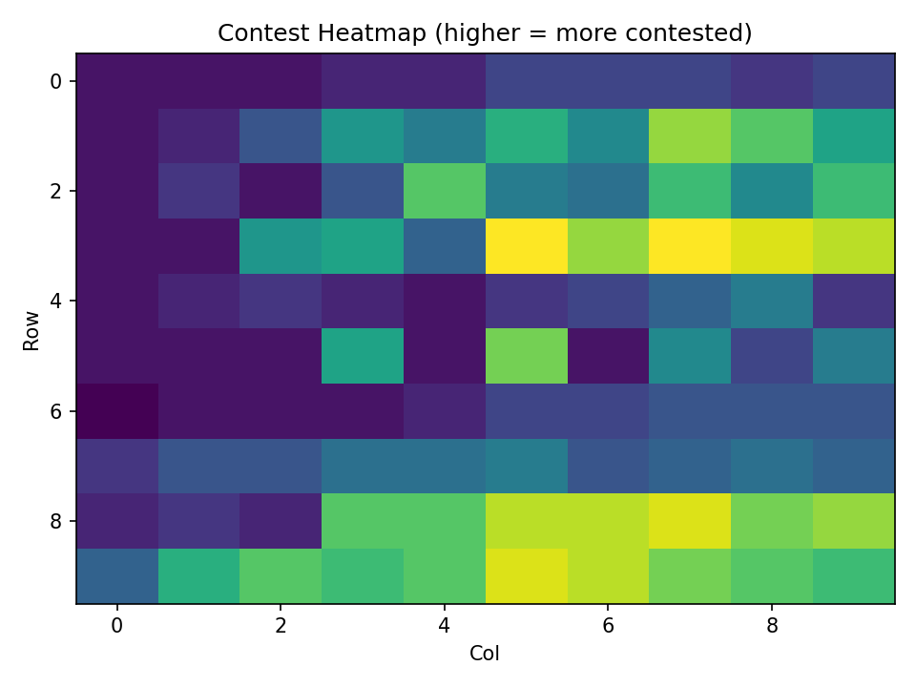
Overall description of the experiment setup
In order to test the formation mechanism of property rights in anarchy, we design and implement a simulation environment based on multi-agents. The environment reproduces the core elements of the "California Gold Rush": a group of homogeneous individuals occupying, mining, and competing for resources to maximize their personal wealth in a "borderless land" with no central authority and no communication channels.

Slide 9
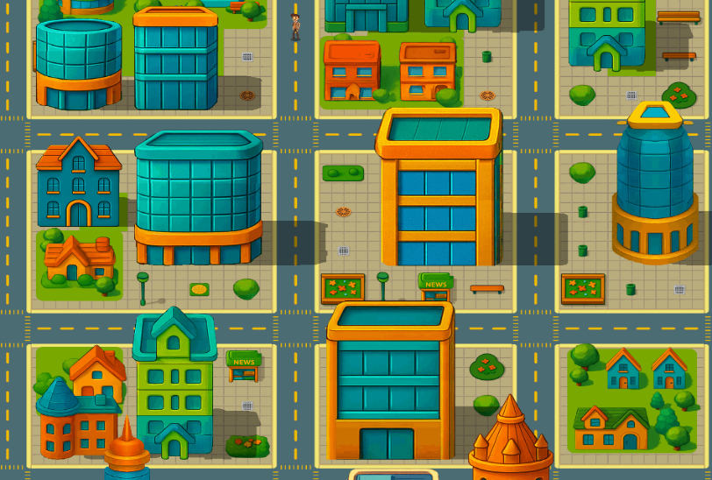



Simulating Environment Settings
Space(Grid):
Resource Homogeneity
Initial Sate
The simulated world is a rows*cols grid containing rows*cols discrete plots.
In the baseline experiment, all plots had the same resource cap.
The simulation begins with all 100 plots unowned

Slide 10
Agent Design
Miners
Stamina
Objective
Information
We run experiments with two population sizes: N agents. In the baseline, all agents are homogeneous with identical capabilities and objectives.
Each agent has a fixed budget of S=10 stamina per round. Stamina resets every round and does not carry over.
The sole objective for each agent is to maximize its cumulative personal gold over the simulation horizon.
Public: At the start of each round, agents observe the global ownership map and the previous round's public event log (conflicts, outcomes, yields per plot).
Private: Agents have internal memory but cannot observe others' current-round intentions (e.g., raid targets, defense commitments), creating strategic uncertainty.

Slide 11
Action & Decision Mechanisms
Each round, agents simultaneously submit an "action bundle" within their stamina budget (S=10), consisting of four action types:
Action | Description | Stamina Cost
Claim | Attempt to acquire an unowned plot. | 1 per plot
Raid | Attack an owned plot to seize ownership. | 1 per plot
Defend | Pre-commit defense to a currently owned plot. | 1 per plot
Mine | Allocate stamina to extract gold from an owned plot. | 1-3 per plot (linear yield)

Slide 12
Submission
All agents submit their action plans simultaneously.
Validation & Budgeting
Illegal actions are removed. Over-budget actions are clipped based on a deterministic priority order.
Claim Conflicts
If multiple agents claim the same unowned plot, a single winner is chosen via a Random Number Generator (RNG). All participants pay the stamina cost.
Raid Conflicts:
If the owner committed 1 stamina to "defend", all raids on that plot fail. Defense is absolute for the round.
If undefended, one raider is randomly selected as the new owner. Ownership transfers immediately.
Logging & Reset
Mining
After all ownership changes are resolved, the current owner of each plot earns gold based on their mining allocation. Stamina allocated to mining a plot that was lost during the round is forfeited.
All agents' stamina is reset to S=10 for the next round.
Round Resolution
Each round simulates a day in the life of a prospector, from dawn till dusk. Agents must strategically budget their limited stamina to stake new claims, defend their land, raid rivals, and mine for gold. The process unfolds in a fixed, deterministic sequence to ensure fairness.

Slide 13

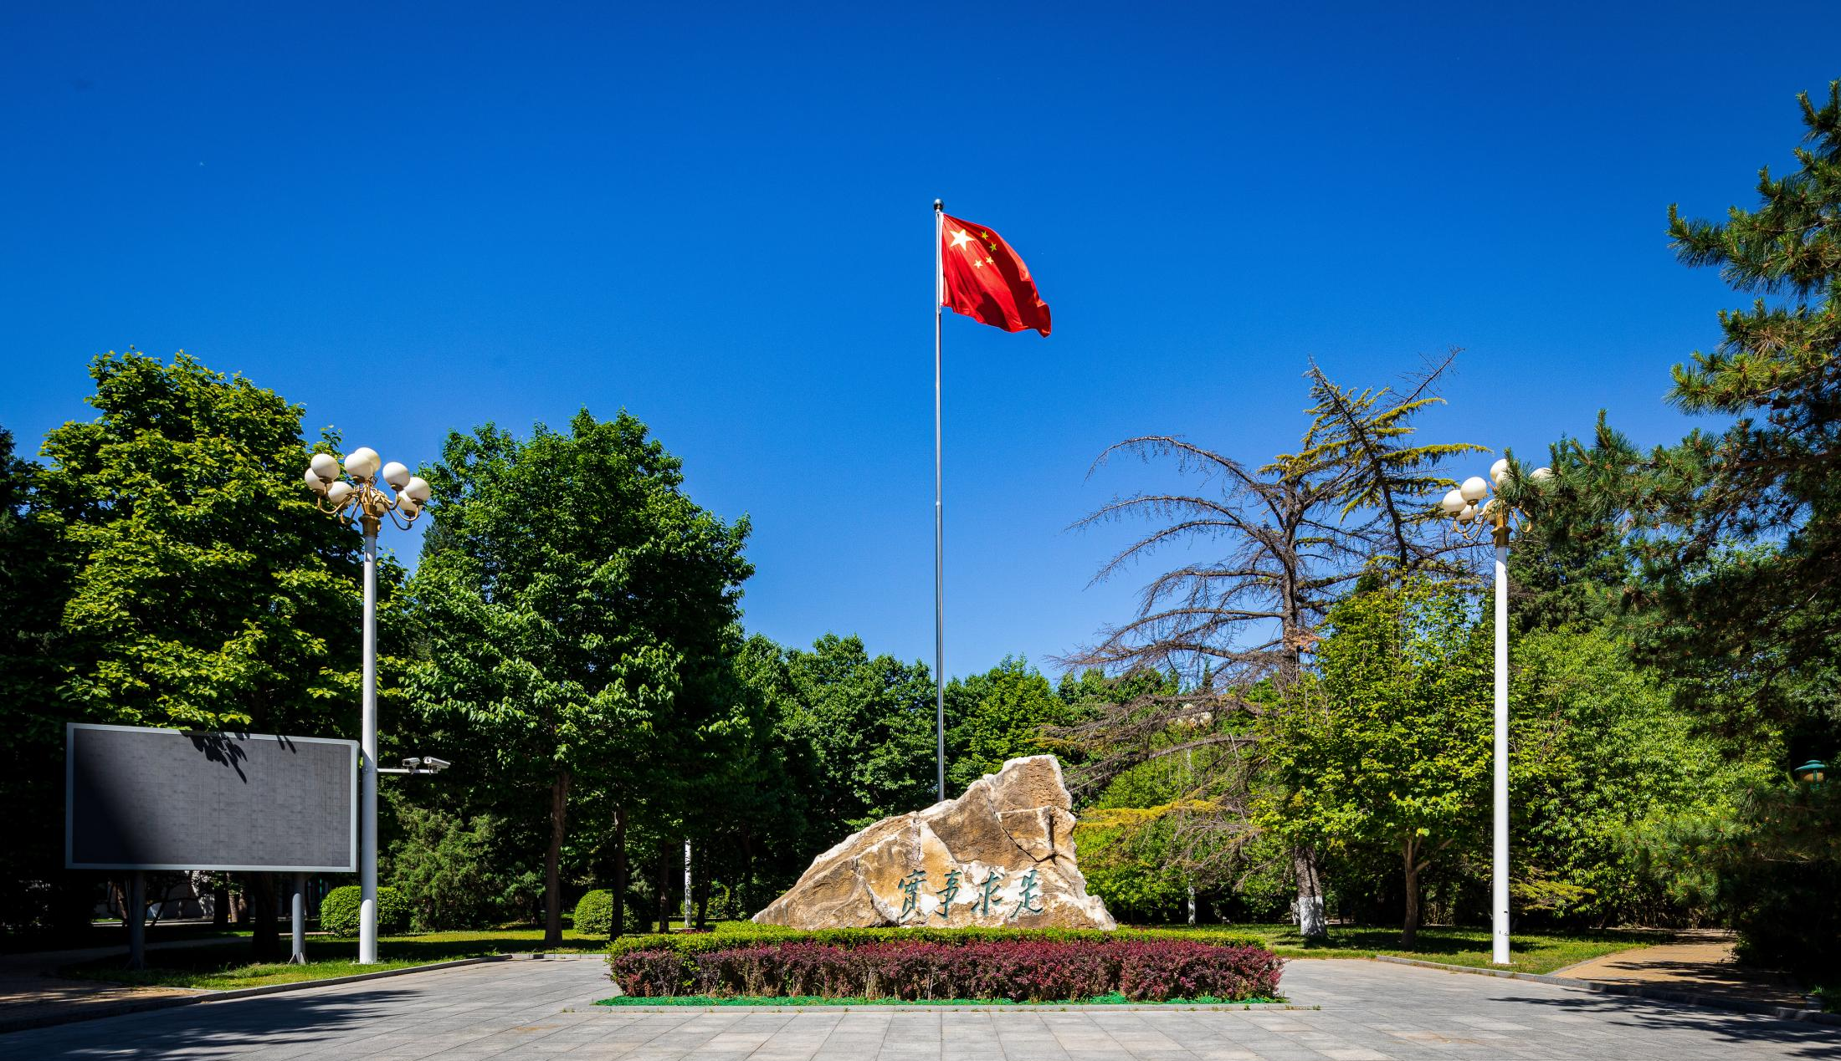
04
Experimental
group and
control group

Slide 14
Model Abstraction:
From Gold Rush to Grid World
Real-World Concept | Simulation Mechanic
Anarchy / No Authority | No central server to coordinate actions; agents submit plans simultaneously.
Violence / Physical Power | Stamina (S=10): A fixed budget for all actions (claiming, raiding, defending, mining). This is the quantifiable proxy for "might".
Unclaimed Land | Rows x Cols Homogeneous Grid: All plots are initially unowned and identical in value.
Competition & Conflict | Claim/Raid/Defend Actions: Direct, costly mechanisms for acquiring and protecting property.
Rational Self-Interest | Objective Function: Maximize cumulative personal gold.
Emergent Rules | Property Rights: The stable ownership map that emerges from agent interactions over many rounds.

Slide 15
Experimental Design: LLM vs. Baseline
Treatment Group:
LLM-driven Agents
Control Group:
Heuristic Baseline Agents
  Decision Making: Utilizes the Magnolia Large Model to make complex, strategic decisions under uncertainty.
  Behavior: Capable of learning, adaptation, and potentially "human-like" behaviors (e.g., forming temporary truces, retaliating, testing opponents).
  Purpose: To test if complex, language-based reasoning can lead to the emergence of order.
  Decision Making: Follows a simple, pre-defined rational script (e.g., "1. Claim empty plots until I own my fair share (100/N). 2. Once share is met, only mine and defend. 3. Do not initiate raids.").
  Behavior: Perfectly rational, predictable, and non-aggressive once territory is established.
  Purpose: To validate the simulation environment. If even these simple agents converge to a stable, equal state, it proves our game mechanics are well-founded. This provides a benchmark for the LLM's performance and behavior.

Slide 16

05
My code
Research Process

Slide 17
Prompt Engineering:
Translating Rules into Reasoning
claim empty plot (r,c) → costs 1
raid someone else’s plot (r,c) → costs 1
defend own plot (r,c) → costs 1 even if nobody raids;
mine own plot (r,c) with stamina ⁡0..s_{max} → yields q⋅min⁡(s , s_{max⁡} )
Discrete grid R×C; N miners; per-round stamina S (reset); per-plot mining S，no authority.
Setting
Action types
and
consequences
Your
objective
Maximize cumulative gold while improving system efficiency; balance expansion (claim/raid) vs protection (defend) vs extraction (mine).

Slide 18
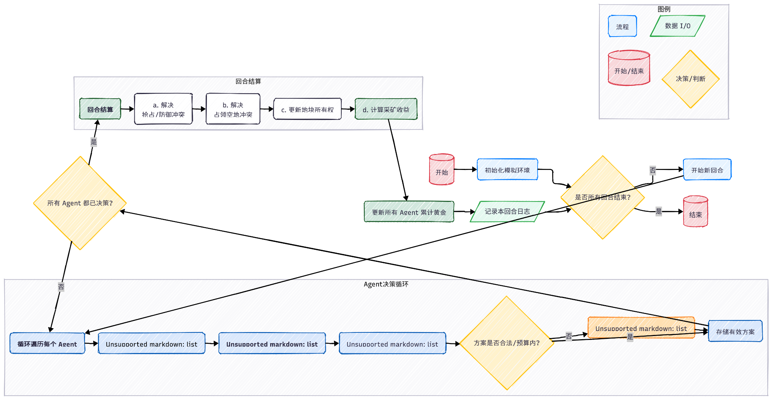
Code flow

Slide 19
06
Property & Conflict
results

Slide 20
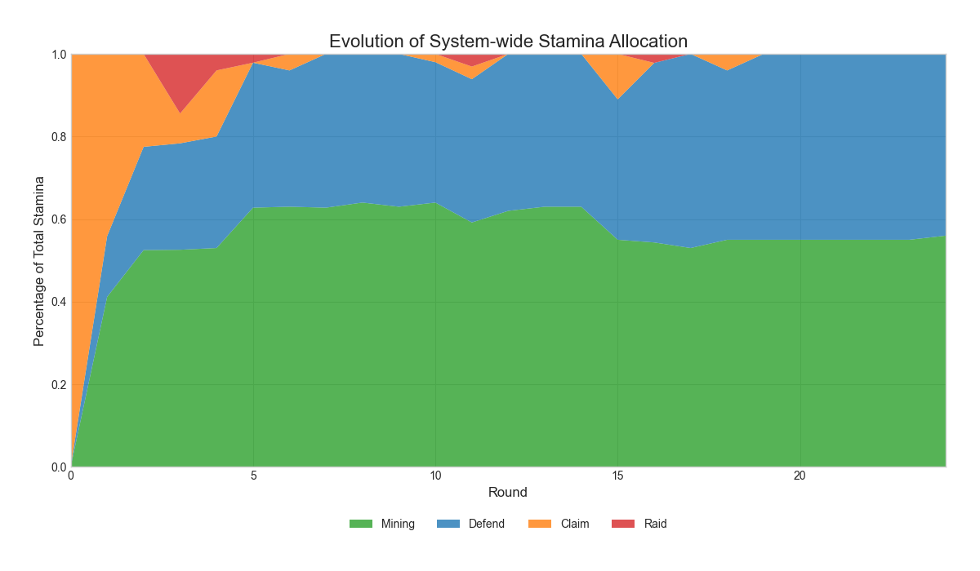
The spontaneous emergence
of order in the baseline scenario
In this study's baseline scenario (10x10 grid, 10 agents), we observed a clear evolution from high chaos to relative order. The initial simulation was characterized by frequent conflicts and unstable territorial ownership. However, over time, the system gradually converged to a stable equilibrium, in which productive activities replaced aggressive behavior as the dominant allocation of agent energy. Subsequent analysis will quantitatively demonstrate this process from three dimensions: strategy evolution, property rights stability, and wealth distribution.

Slide 21
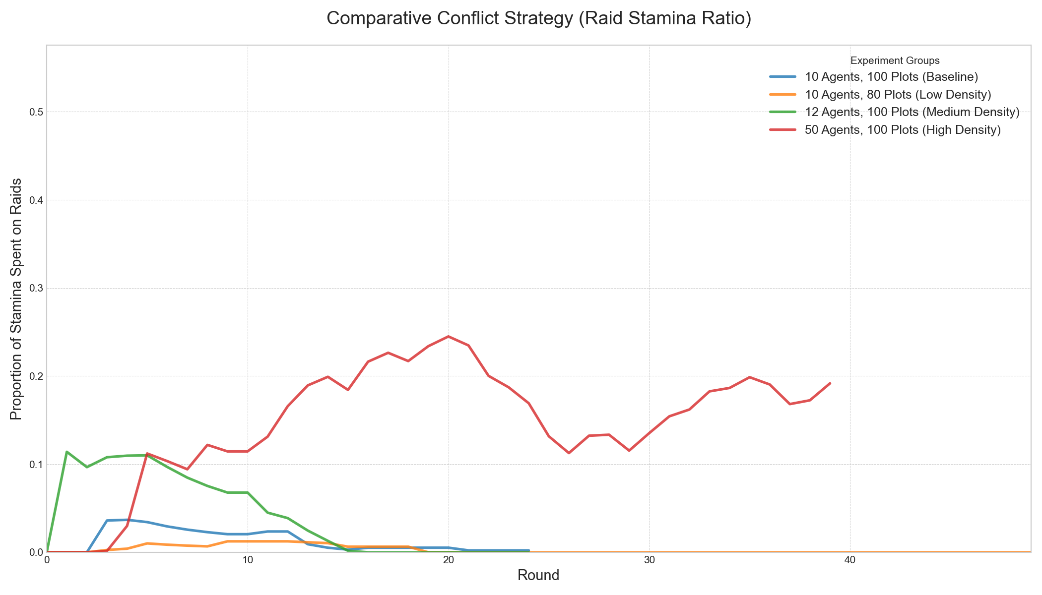
Macroevolution of Agent Strategies:
From Predation to Production
Phase 1
Unorganized Expansion (approximately 0-5 rounds).
Phase 2
Defense Construction (approximately 6-15 rounds).
Phase 3
Stable Production (approximately after 16 rounds).

Slide 22
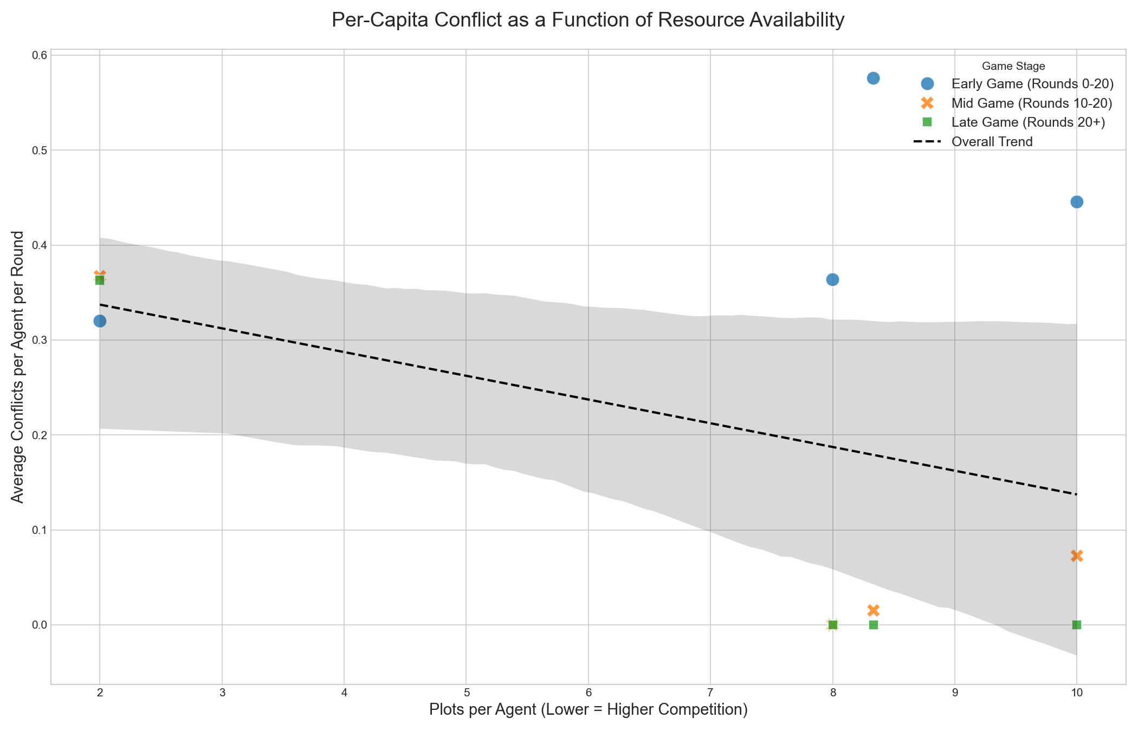
Quantitative relationship between
competitive pressure and conflict behavior
"conflict curve": the less land per capita, the more frequent individual aggressive behavior.
Stage-by-stage evolution：Regardless of the initial competitive pressure (i.e., regardless of their position on the X-axis), over time (as the color and shape of the dots change from "Early Game" to "Late Game"), all dots shift downward, ultimately approaching a zero-conflict equilibrium.
Conclusion: This graph not only confirms our core assumption—that society will eventually move toward order—but more importantly, it reveals that the path and speed of this movement toward order are determined by the initial pressure of resource competition. This is a universal law, not just a random phenomenon in a single simulation.

Slide 23
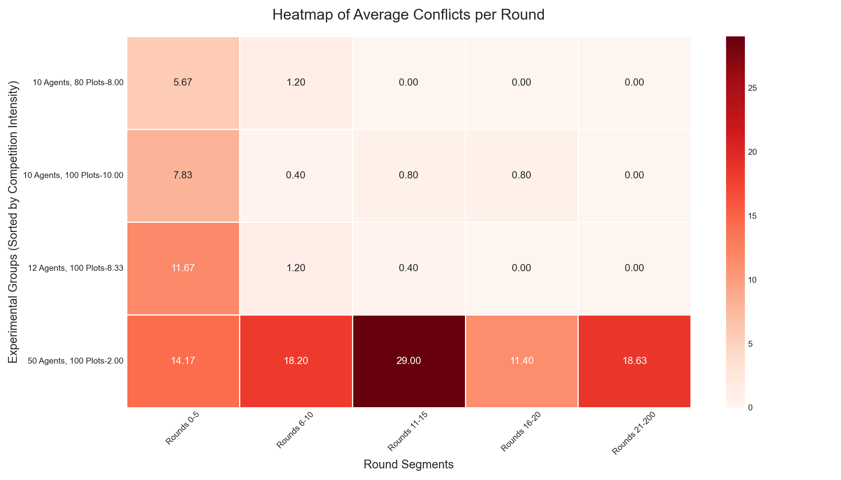
Macroevolution of Agent Strategies:
From Predation to Production
This heatmap visualizes the data from the table, making the conclusions immediately apparent.
The darker the color, the more intense the conflict.
We can observe a clear gradient from the light-colored area in the upper-left (early rounds, low density) to the deep red area in the lower-right (early rounds, high density).
The deepening of color from top to bottom illustrates the escalation of conflict driven by increased competition.
Conversely, the lightening of color from left to right reveals the common trajectory of all systems toward a peaceful state

Slide 24
Macroevolution of Agent Strategies:
From Predation to Production
To quantify the speed at which order is formed under different competitive pressures, we created this summary table of conflict dynamics. The rows represent different experimental groups, the columns represent different time periods, and the values in the cells are the average number of conflicts per round in that phase.
Although all anarchic societies can eventually spontaneously move towards order, the intensity of the initial competition is the key variable that determines how long and "bloody" this road will be.
Group | Plots per Agent | Rounds 0-5 | Rounds 6-10 | Rounds 11-15 | Rounds 16-20 | Rounds 21-200
10 Agents, 80 Plots | 8.00 | 5.67 | 1.20 | 0.00 | 0.00 | 0.00
10 Agents, 100 Plots | 10.00 | 7.83 | 0.40 | 0.80 | 0.80 | 0.00
12 Agents, 100 Plots | 8.33 | 11.67 | 1.20 | 0.40 | 0.00 | 0.00
50 Agents, 100 Plots | 2.00 | 14.17 | 18.20 | 29.00 | 11.40 | 18.63

Slide 25
07
Property & Wealth
results

Slide 26
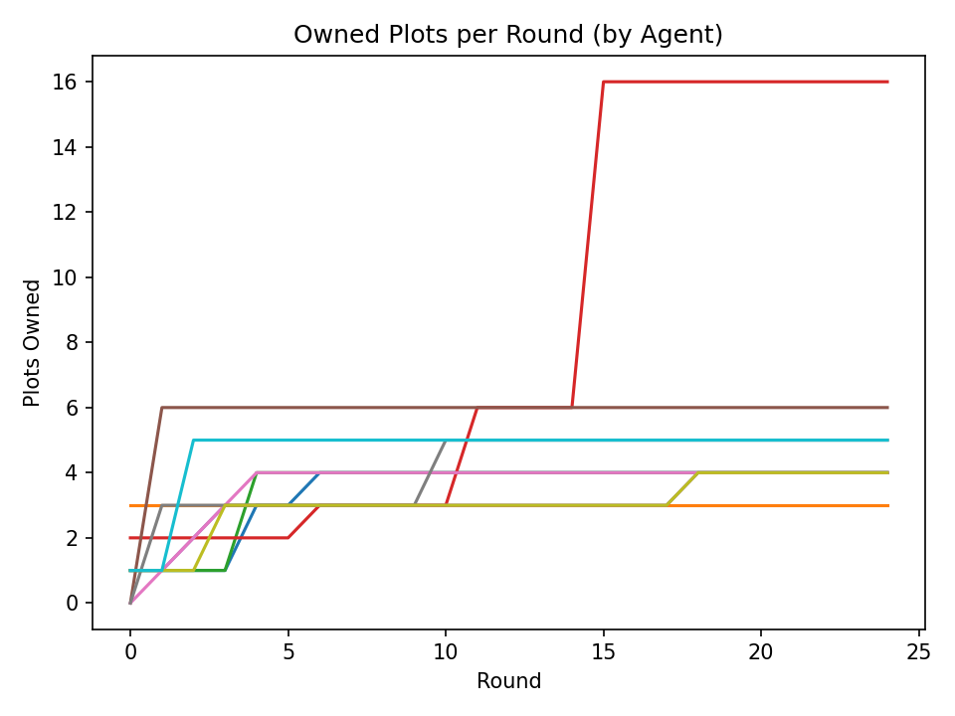
The Stabilization of Property Rights
In the early days of the experiment (on the left), the lines fluctuated violently and frequently intersected, which represented a chaotic period of extremely unstable property rights, and the land frequently changed hands in constant competition.
However, over time, we can see a clear trend: all lines gradually flatten out and converge into a narrow range. This shows that a stable property rights structure has been formed spontaneously. From endless struggles, agents have 'learned' to respect each other's territory.
This diagram is the starting point of our story: it proves that even in the absence of external laws, a stable property order can emerge spontaneously from chaos.
10 agents，10×10 grids

Slide 27
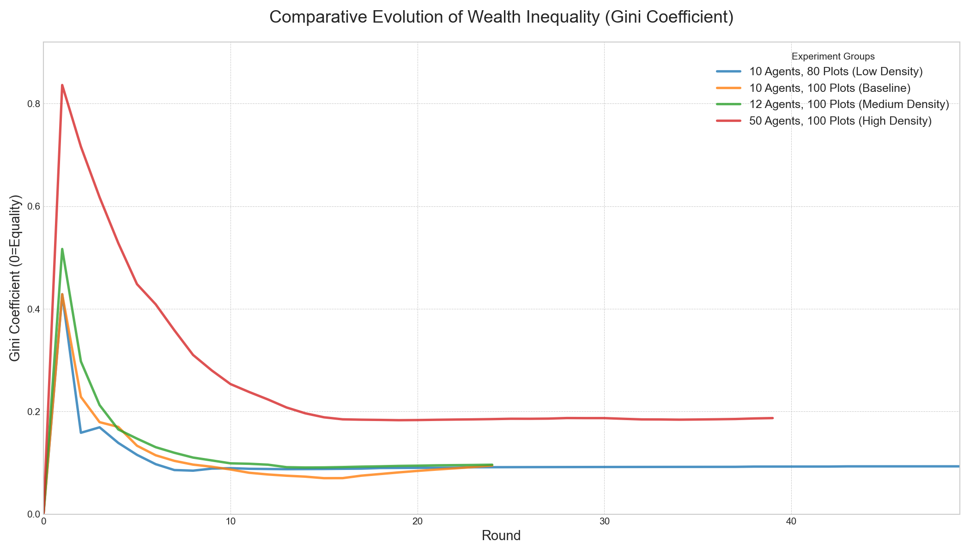
Process：The slow Path To Equality
Gini Coefficient Evolution: This chart tracks wealth inequality over time. All groups trend towards equality, confirming the emergence of a stable order.
Competition Slows Convergence: The High-Density group (50 Agents) shows a significantly slower decline in inequality and stabilizes at a higher Gini value.
Conclusion: Increased competition does not prevent the formation of order, but it severely delays the process of achieving a fair distribution of wealth.
What is the Gini Coefficient?
A measure of statistical dispersion intended to represent the wealth inequality within a nation or a social group. A Gini coefficient of 0 reflects perfect equality, while a coefficient of 1 implies maximal inequality.

Slide 28
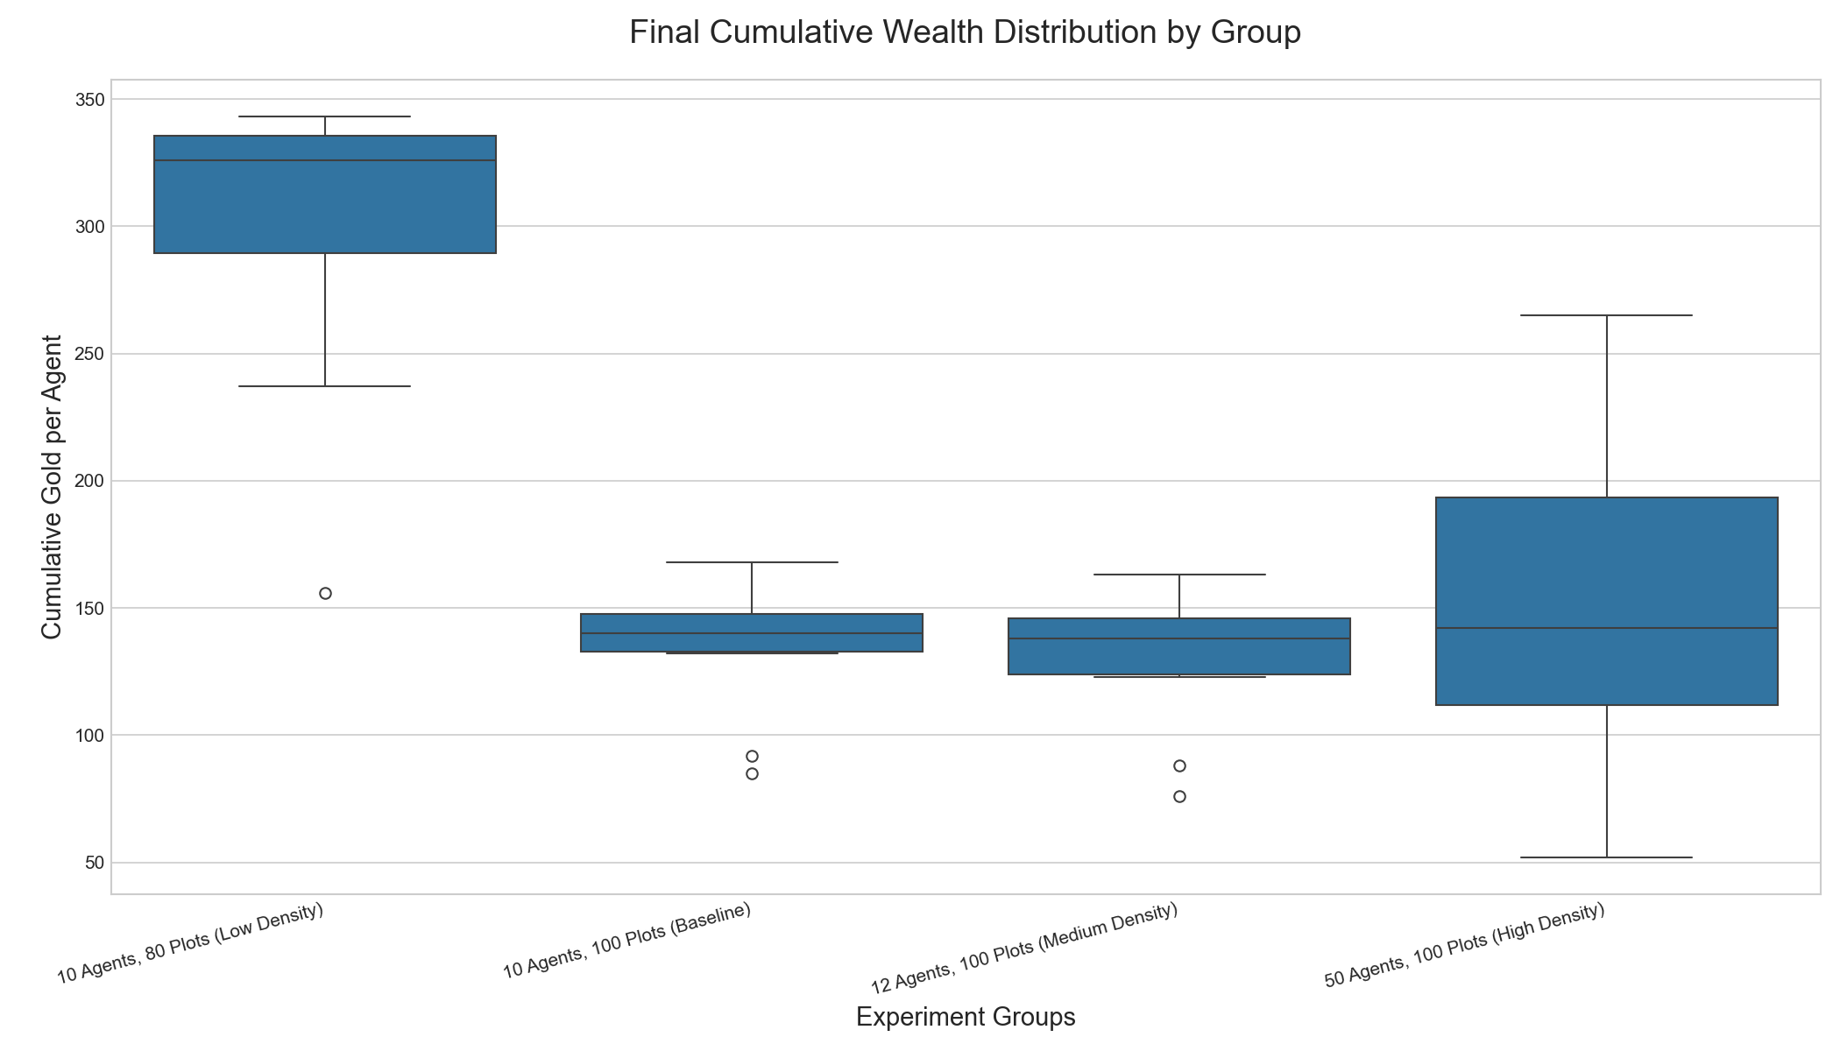
Outcome: A Less Equal Destination
Final Wealth Distribution: This boxplot compares the final wealth of every agent across the different groups. The height of the box indicates the degree of wealth disparity.
Inequality Amplified : As population density increases (left to right), the wealth distribution becomes wider and more skewed.The High-Density group exhibits the largest gap between its wealthiest and poorest agents.
Conclusion: High competition not only slows the path to equality but also results in a less equal final outcome.

Slide 29
08
Agent & Human
results

Slide 30
How our simulation
correspond to real-world scenarios
Collective regularities
As this norm diffuses, raids fall, ownership stabilizes, efficiency rises; spatial clustering and takeover hierarchies emerge even on a homogeneous grid—patterns consistent with classic field narratives of camps moving from violent contest to workable customs.
Endogenous constraint
Because undefended mining is wasteful and defense blocks all raids, agents discover (not hard-code) the rule-of-thumb: defend what you mine.
No law, scarce stamina, open land
Initial “grab” phase replicates the rush: many claims, frequent takeovers, high churn.

Slide 31
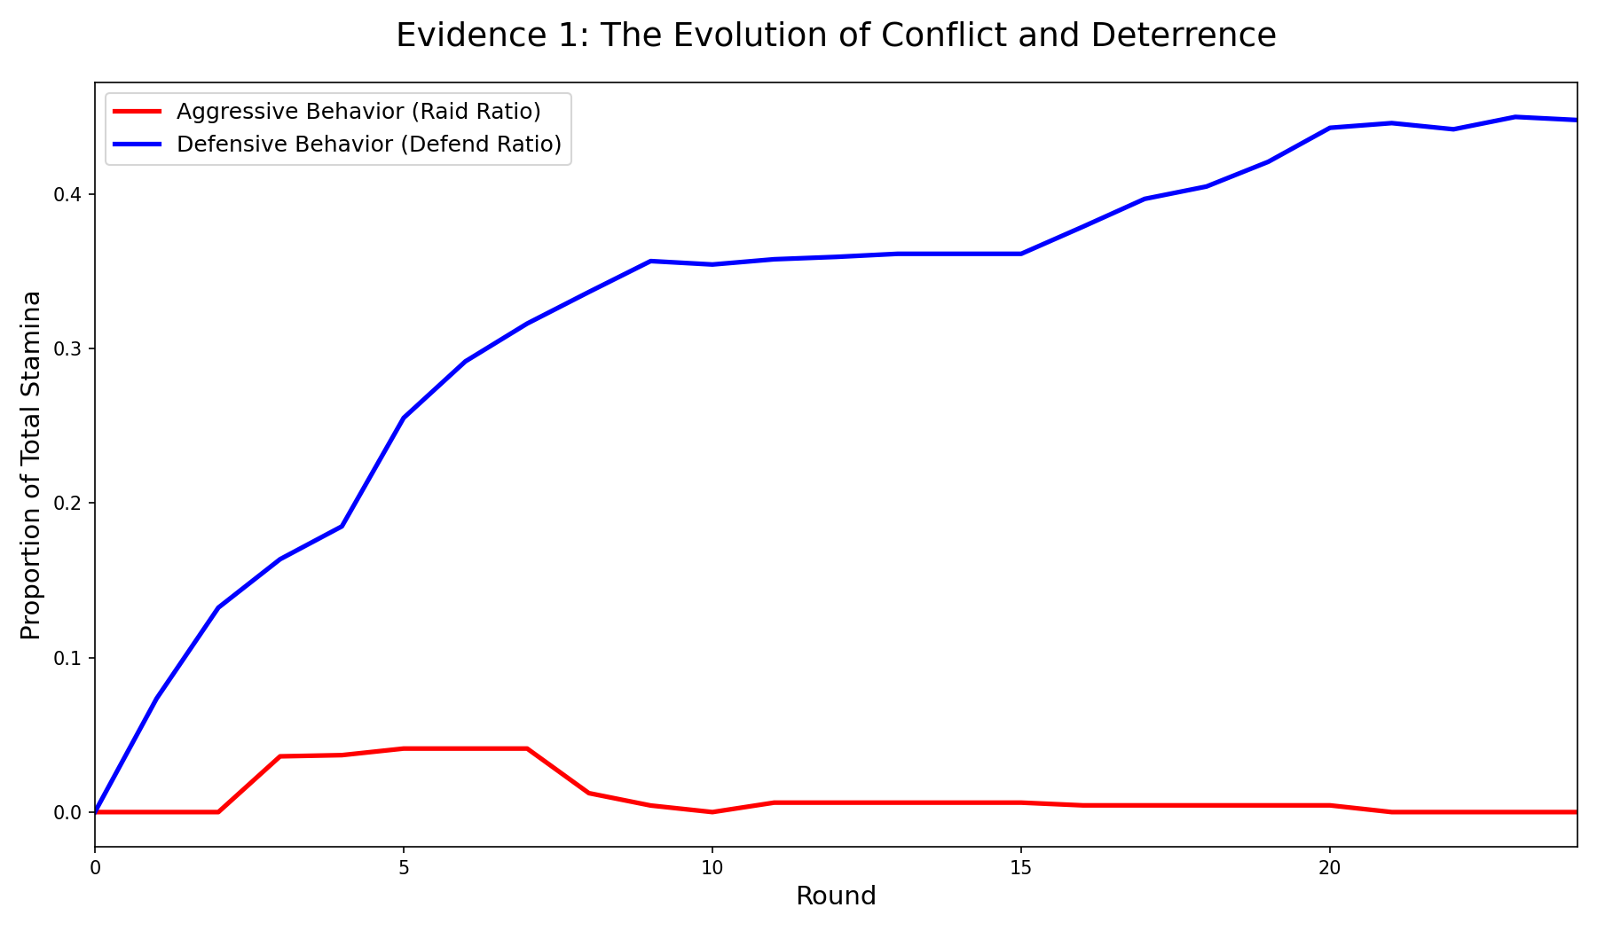
Evidence 1
LLM Agents Learn the Logic of Deterrence
Umbeck's Finding: In anarchy, the potential for violence (deterrence) is the ultimate constraint that shapes property rights. Individuals must invest in defense to protect their claims.
Our Simulation Shows:
  Initial Chaos
  The Rise of Defense
  Order Emerges
Conclusion: Our LLM agents replicated the core logic of deterrence described by Umbeck. They learned that investing in "might" (defense) is essential for securing property, which in turn reduces overall conflict.
Baseline Scenario: 10 agents, 10x10 grid (100 plots)

Slide 32
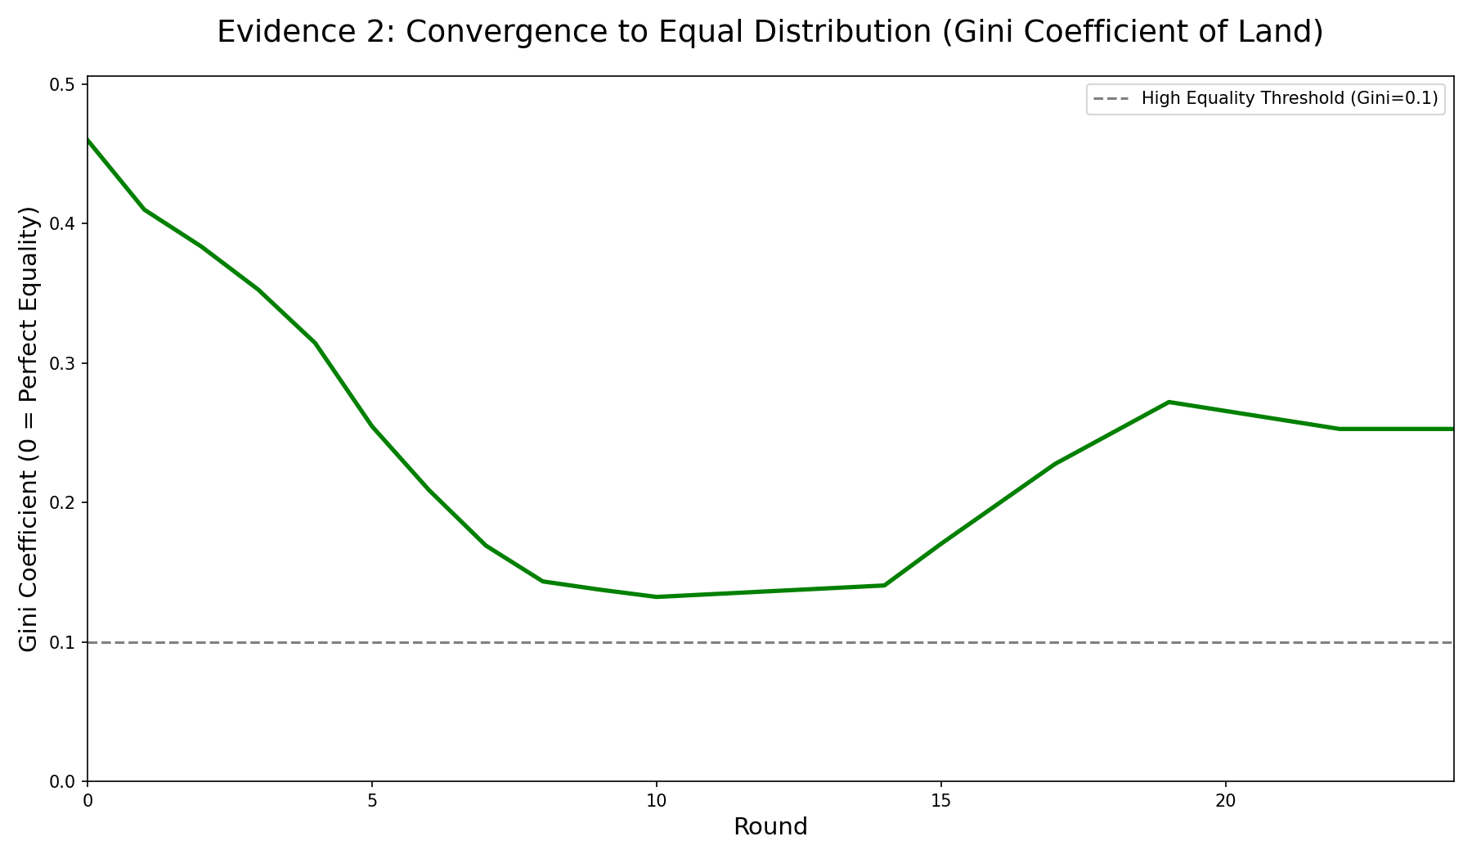
Evidence 2 ：A Spontaneous, but Imperfect, Convergence Towards Equality
Umbeck's Prediction: Perfectly rational agents should achieve a perfectly equal distribution (Gini = 0).
Our Simulation Shows:
  The Gini Coefficient shows a strong and rapid trend of declining inequality, confirming the emergence of order.
  The system converges to a state of high equality
  Crucially, the system does not reach perfect equality. A low level of inequality persists, reflecting a more realistic equilibrium with minor, ongoing frictions.
Conclusion:
  LLM agents replicate the fundamental trend towards equality predicted by rational choice theory.
  The “imperfect” outcome demonstrates the model‘s strength: it captures a more nuanced reality where order is achieved.
Baseline Scenario: 10 agents, 10x10 grid (100 plots)

Slide 33
09
Agent & Human
Contribution
Creativity

Slide 34
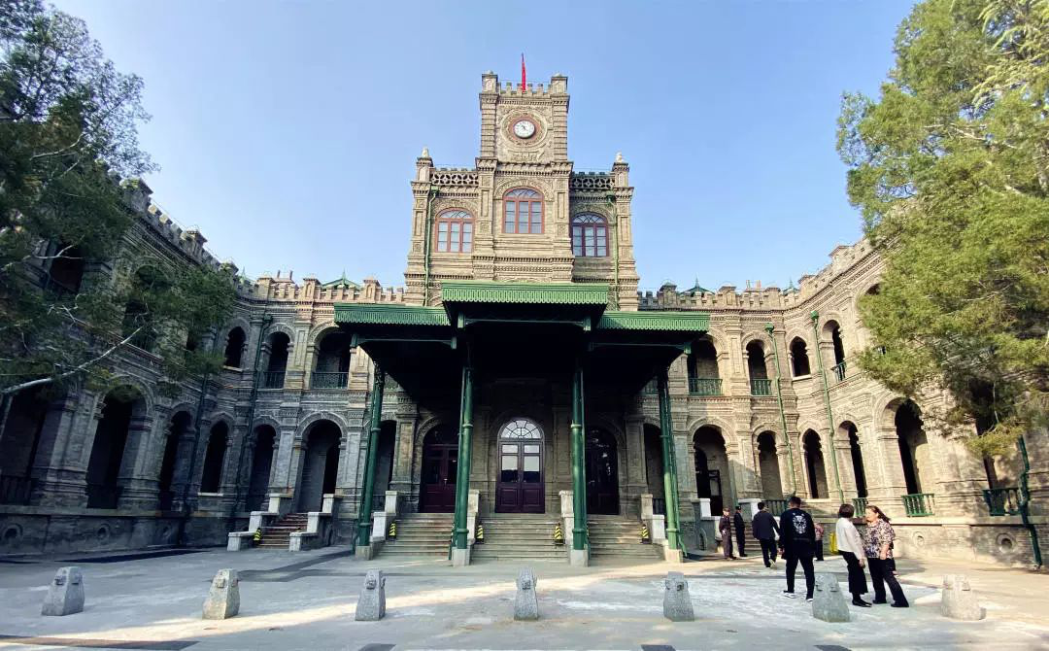
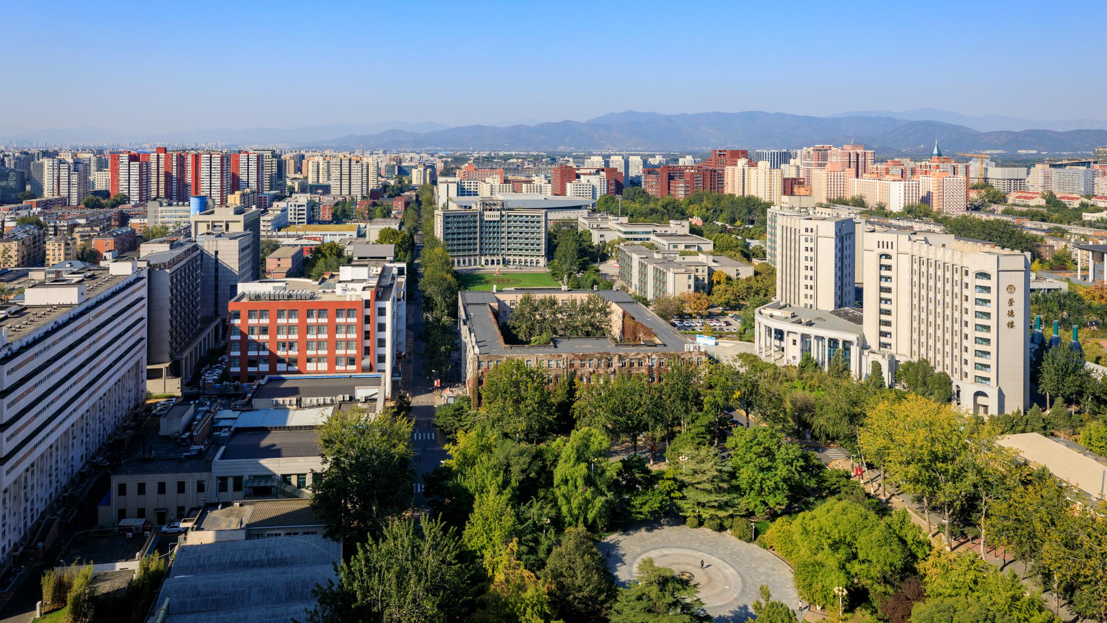
Our contribution
Testing "Un-testable "
Theories
Reducing the cost of sociological research
Reproducibility of LLM simulations
Verification of Umbeck's theory
Uncovering the "Invisible Hand" of Anarchy
Macro regularities from micro rules

Slide 35
Innovation Badge
Validated LLM-Agents as a powerful digital laboratory for computational social science.
A New Paradigm
Provided the first agent-based, empirical validation of Umbeck's "Might Makes Rights" theory.
Theory Validation
Demonstrated how implicit social norms (property rights) can emerge from costly signaling in a zero-communication
Modeling Tacit Coordination
Transformed a static equilibrium theory into a dynamic, multi-stage evolutionary process
Conflict Curve & Path to order

Slide 36
10
Agent & Human
Future work

Slide 37
Future Directions
Agent heterogeneity: introduce agents with varying stamina budgets to test how power inequality shapes the final distribution of property.
Dynamic environments: introduce resource depletion or random discovery of "gold mines" to test the resilience and adaptability of the established order.
Strategic geography: create a non-homogeneous grid with chokepoints and resource hubs to study the influence of terrain on conflict and territory formation.
Emergence of governance: allow agents to pay a "tax" to a central enforcer to study the spontaneous formation of a proto-state.
Communication & contracts: enable limited messaging for agents to negotiate treaties, form alliances, and establish explicit rules.
Cultural norms: use prompt engineering to instill different cultural values (e.g., individualist vs. collectivist) to examine their impact on institutional formation.

Slide 38

Thanks!
Thanks for watching
Writer : Shiyu Liu

